Slide 1
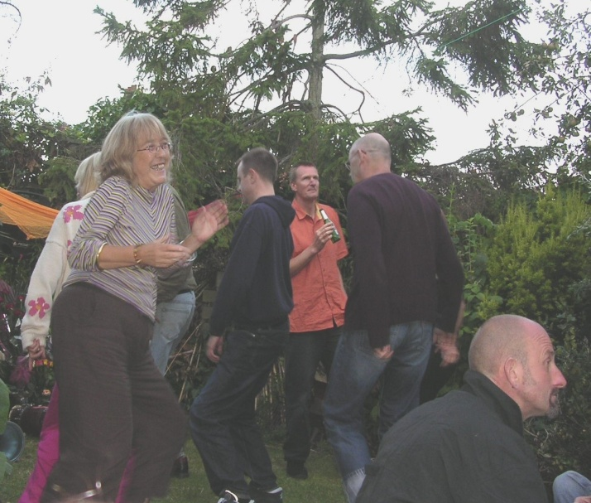
Scottish Government Offices
Victoria Quay
EDINBURGH
22nd May 2014
Review of the Antisocial Behaviour Noise Provisions
The Scottish Government are in the process of a Call for Evidence to support a policy review of the Noise Regime under Part 5 of the Antisocial Behaviour (Scotland) Act 2005.
The noise provisions were designed to be enabling and flexible with each local authority deciding whether to adopt the noise provisions depending on their local circumstances.
This free one day workshop run on behalf of the Scottish Government and in conjunction with Noise Action Week will focus on all aspects of the call for evidence and we invite you to input directly on how the noise regime in Scotland can be taken forward.
© Mary Stevens
Who should attend?
The nature of this event means that attendance is restricted to Environmental Health Officers, Antisocial Behaviour Officers and housing officers. Places are limited to 2 delegates from each authority with a third being placed on a reserve list and allocated any unfilled places. These will be offered strictly on a first come, first served basis.
For the Attention of REHIS members – Participation in this event carries a maximum value of 4.15 hours (core activity) for the REHIS Scheme of Continuing Professional Development.
Working towards a cleaner, quieter, healthier, sustainable Scotland
Environmental Protection Scotland 3rd Floor, 231 George Street, GLASGOW, G1 1RX | Tel: 0141 287 6530 Email: admin@ep-scotland.org.uk Follow us on Twitter: @EPScotland
www.ep-scotland.org.uk Environmental Protection Scotland is a Scottish Charitable Incorporated Organisation. Scottish Charity No. SC043410

Slide 2
Scottish Government Offices
Victoria Quay
EDINBURGH
22nd May 2014
Programme
09:30 | Registration / Tea and coffee
10.25 | Welcome and Introduction Linda Story, The Scottish Government
Workshop 1
10:40 | Enabling and Flexible Complementary Powers Alternative quick resolution
11:40 | Tea and coffee
Workshop 2
11:55 | Powers Noise Levels and Periods Measurement Protocols
12:55 | Lunch
Workshop 3
13:40 | Training Guidance
14:20 | Comfort Break
14:45 | Feedback and discussion
15:45 | Summary & Close
Appointing Organisation:
Please register the following delegates: Name
Email address for correspondence Name
Email address for correspondence
Please complete the form return to:
Environmental Protection Scotland
231 George Street, GLASGOW, G1 1RX
Tel: 0141 287 6530 E-mail: admin@ep-scotland.org.uk Fax: 0141 287 8101
We would like to contact delegates attending this event in future for further events we do. If you DO NOT want your name added to our mailing list please tick here:

